Slide 1
P.E. 3000
Presented By: David Paquin, Ross Imbrock, Charles Kluznik, Joel Varughese, & Alex Echanove

Slide 2
Peer Evaluation Website
Users
Students
Teachers/Admin
Students
See team and course that student is a member of
Evaluations
Peer
Tech Tasks
Teachers/Admin
Create/Edit/Delete teams
Create/Delete evaluations
Create/Delete courses

Slide 3
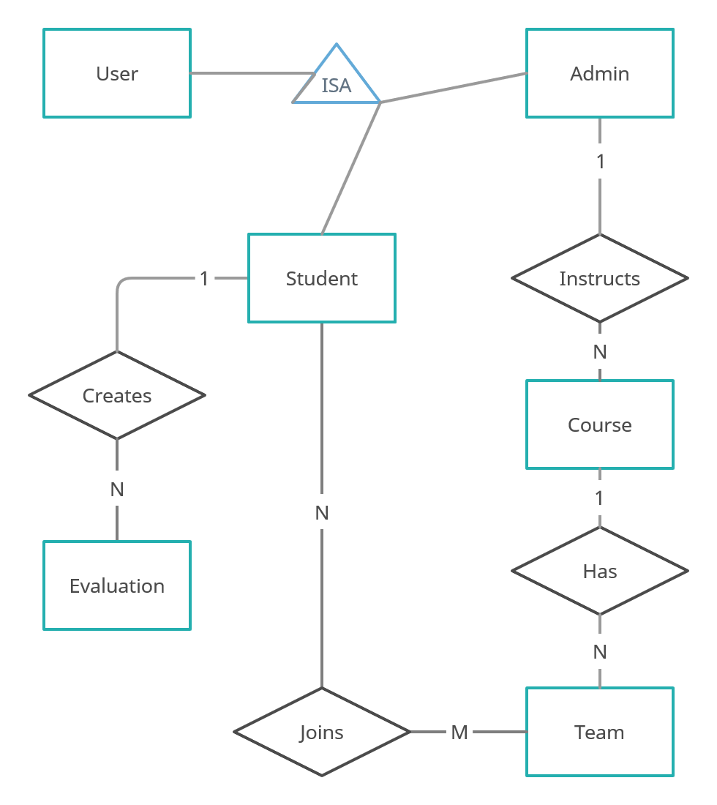
ER Diagram

Slide 4
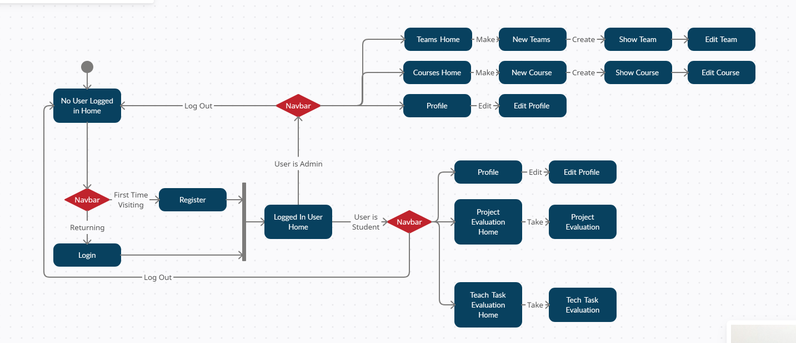
State Diagram

Slide 5
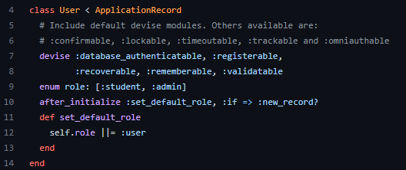
User.rb
Set the role
Student
Admin
Set to default to student

Slide 6
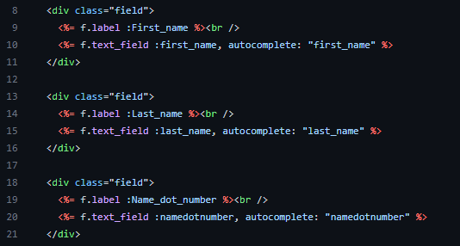

Devise Registration
New entry boxes
First Name
Last Name
Name dot number
Drop down menu
Student
Admin

Slide 7
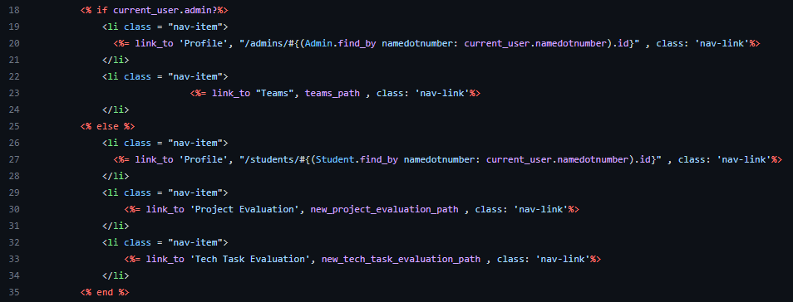
Navbar
Navbar views
Admin
Student

Slide 8
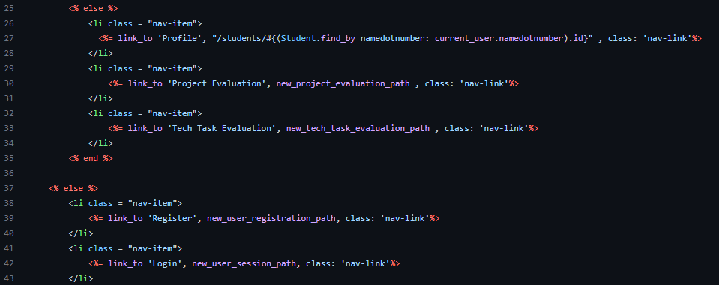
Navbar
Navbar views
Admin
Student

Slide 9
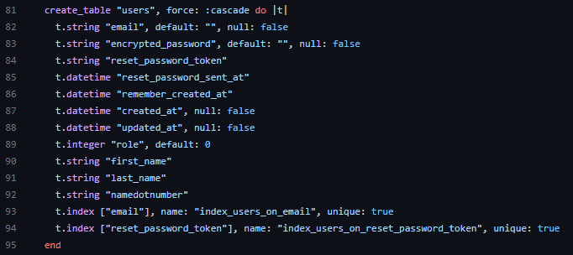
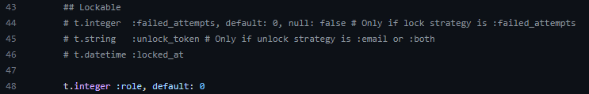
Schema
Database added columns
Role
First name
Last name
Name dot number
Default role

Slide 10



Registration Controller
Route user registration controller
User Registration

Slide 11
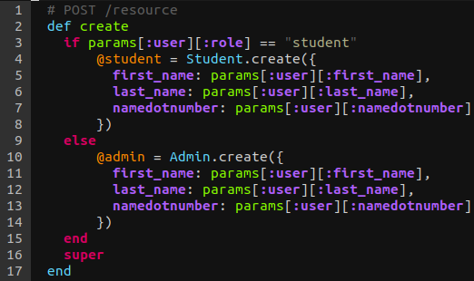
Registering a User
Devise populates the User table when on registration (POST /resource)
We also want to define a new Student or Admin entry on registration
Solution:
Check the role
Create a new Student/Admin
Call “super”

Slide 12
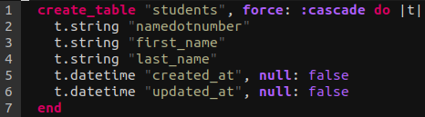
Student Model
A Student:
Is a User
Is part of a Team
Performs Evaluations
Database table schema:

Slide 13
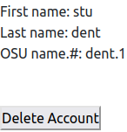

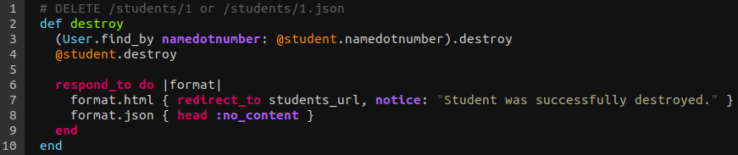
Student Profiles: Show and Destroy Routes
Show lets them view their profile information
Destroy lets them delete their profile

Slide 14
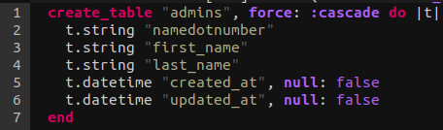
Admin Model
An Admin:
Instructs Courses
Creates Teams
Assigns Students to Teams
Database table schema:

Slide 15
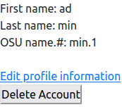
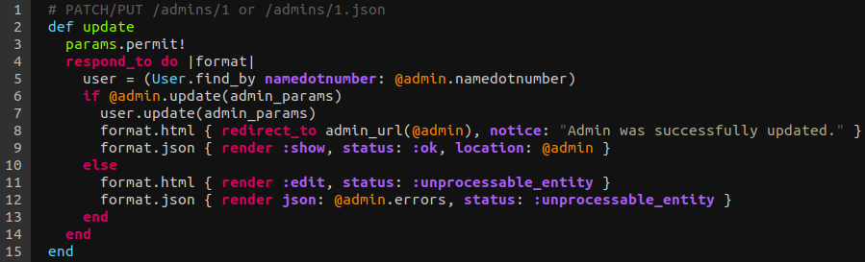
Admin Profile: Show, Delete, and Update
Similar to student profiles
Added permission: ability to edit their profile information

Slide 16
Profile Button Logic
The nav bar holds the Profile button
For students, it leads to their Student profile
For admins, it leads to their Admin profile
How can we know which link to generate?
Solution: Use Devise’s built in current_user variable to query the database

Slide 17
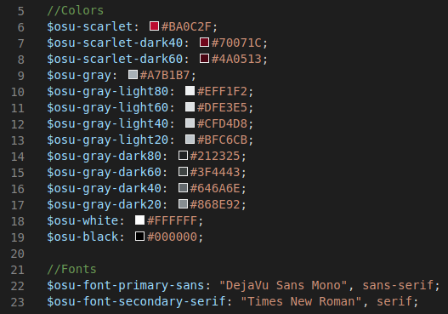
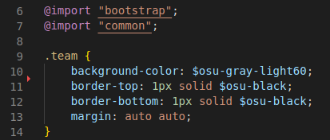
SASS Usage
SCSS files are processed into css stylesheets, allowing for custom variables to be shared between stylesheets
stylesheets/_common.scss
stylesheets/team.scss
Notes:
lllll

Slide 18
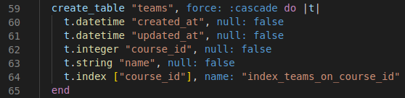
Team: schema.rb
Each team has attributes for the creation time, update time, the course id that it belongs to, and the team name
Notes:
lllll

Slide 19
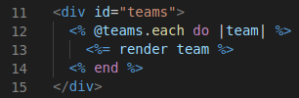
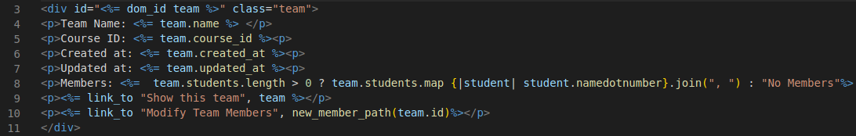
Team: _team.html.erb partial (Render a Team)
The teams page renders a _team partial for each team in the database
The _team partial displays relevant information about a team, a list of its current members, and a link to add/remove members
teams/index.html.erb
teams/_team.html.erb
Notes:
lllll

Slide 20
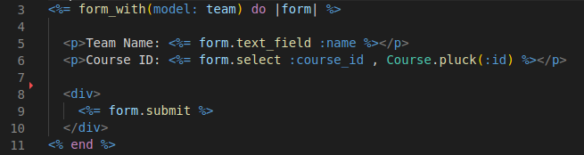
Team: _form.html.erb partial (Create Team)
Admins can create new teams for their courses
Displays a drop down list containing all available course_ids to reference as a foreign key
Notes:
lllll

Slide 21
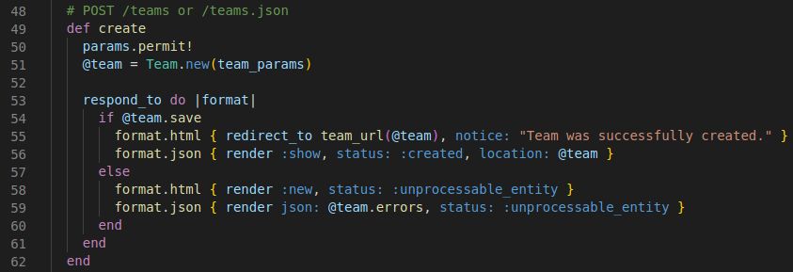
Team: team_controller.rb (Create Team)
The creation form calls the create method in the controller
Upon successful creation, the user is redirected to the team view

Slide 22

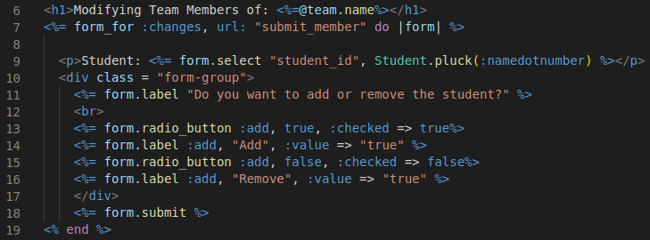
Team: new_member.html.erb (Add/Remove Student)
Admins can add students and remove students from their teams
Displays a drop down list containing all available students to add/remove
controllers/teams_controller.rb
teams/new_member.html.erb
Notes:
llllllllllllllllllllllllllllllllll

Slide 23
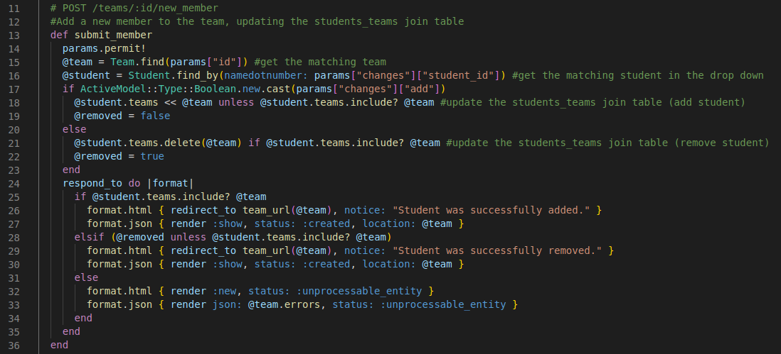
Team: team_controller.rb (Add/Remove Student)
A join table is used to maintain the N students to M teams relationship

Slide 24
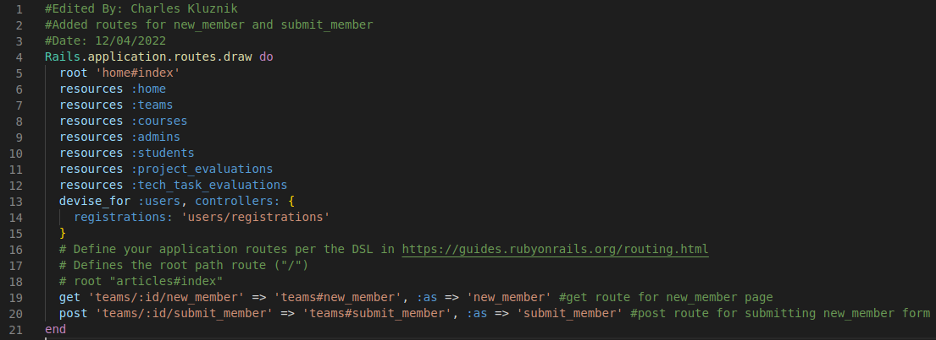
Routes: routes.rb
Custom routes were added for new_member and submit_member

Slide 25
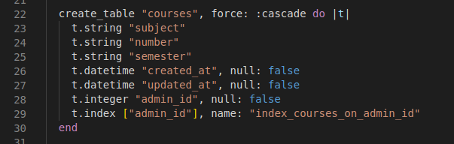
Course: schema.rb
Defining attributes for the courses table

Slide 26
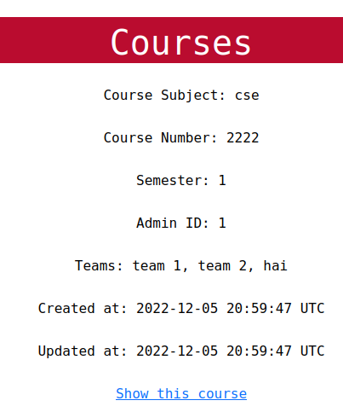
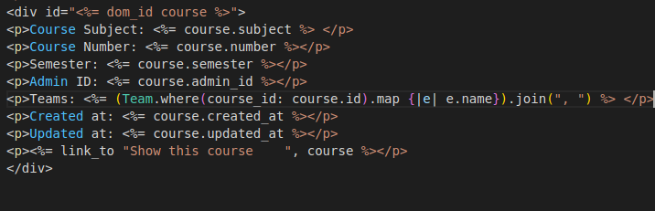
Courses: _course.html.erb partial file
Outputs data from course object
Outputs teams that are part of the course

Slide 27
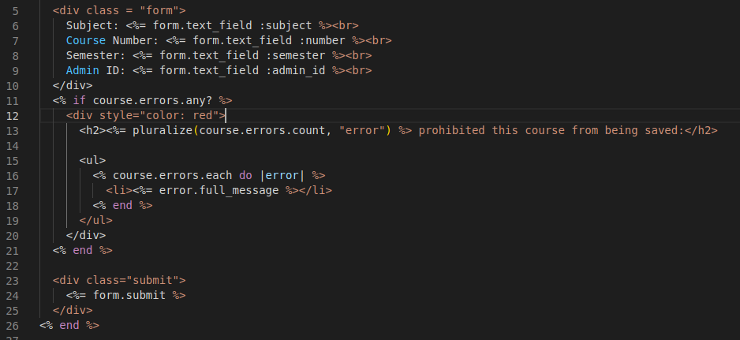
Courses: _form.html.erb partial

Slide 28
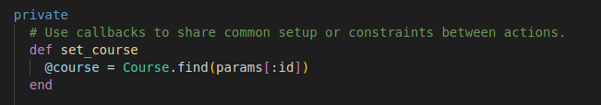
Course: Controller
Before_action is what is called before execution of methods

Slide 29
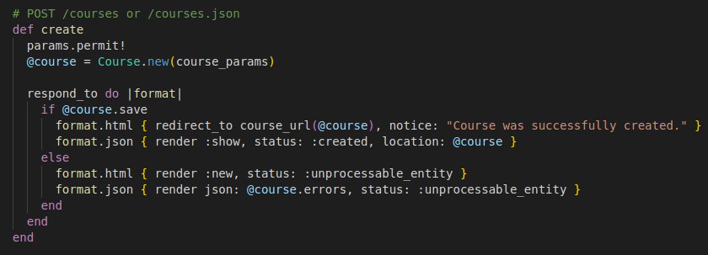
Courses: Controller (Create)

Slide 30
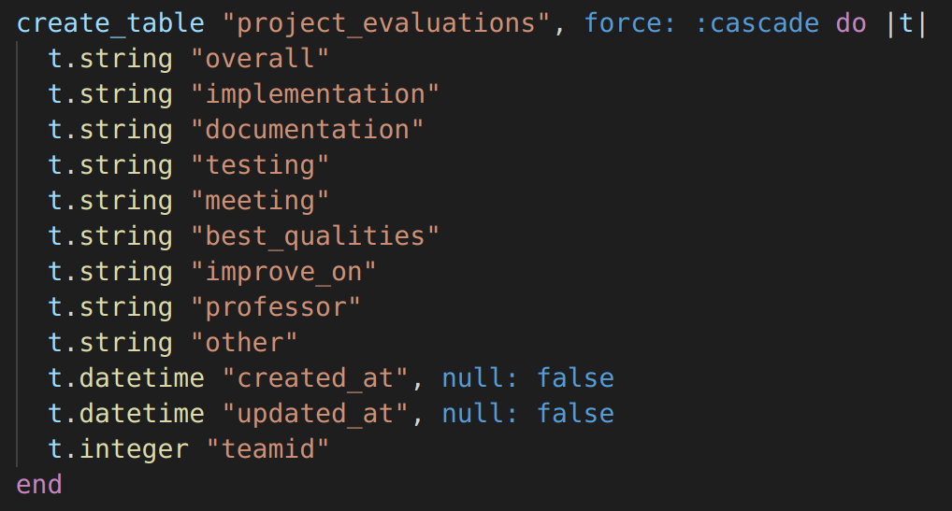
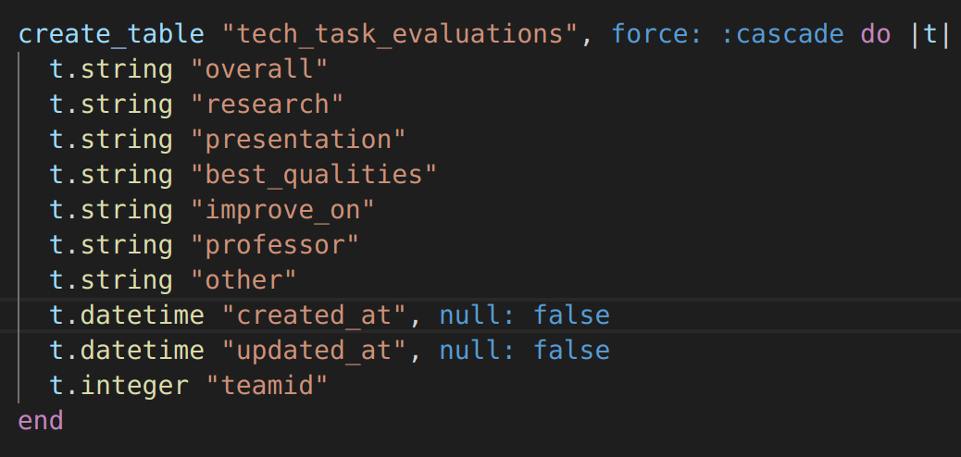
Evaluation Models
An Evaluation is a survey that:
Selects Team
Polls Students
Database table schemas:
db/schema.rb

Slide 31
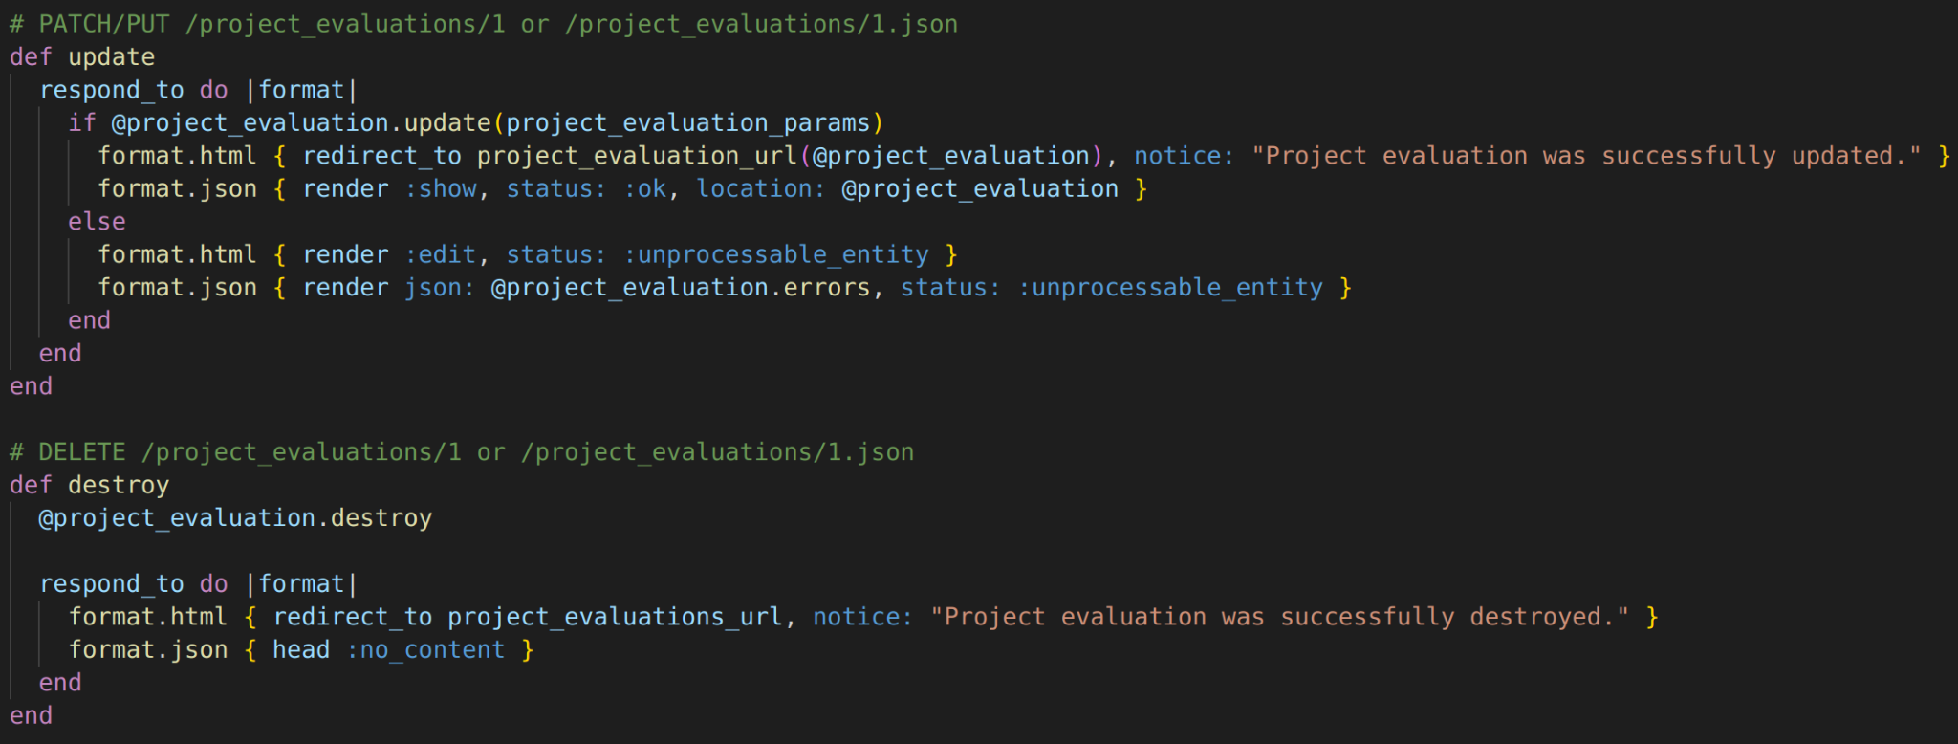
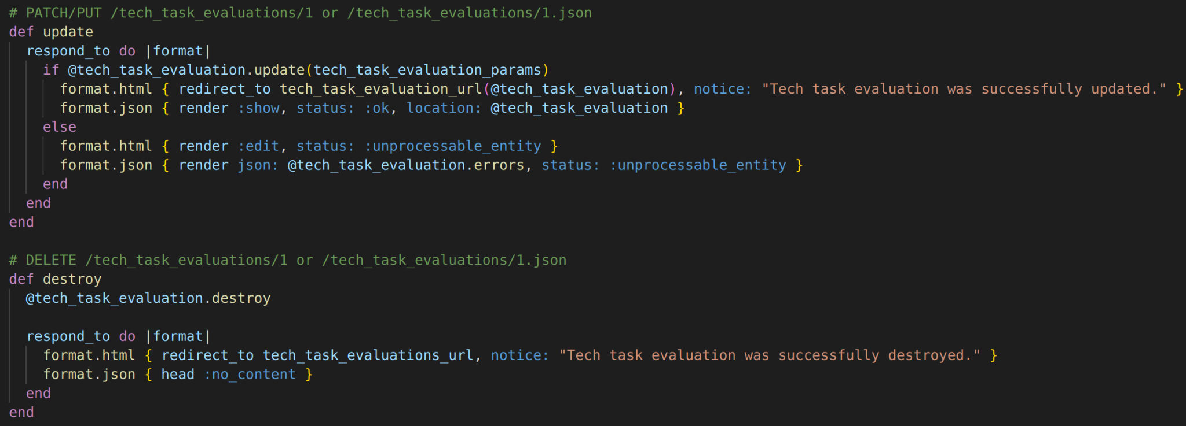
Evaluation: Controllers
Update and Destroy Functions in the controllers
controllers/project_evaluations_controller.rb
controllers/tech_task_evaluations_controller.rb

Slide 32
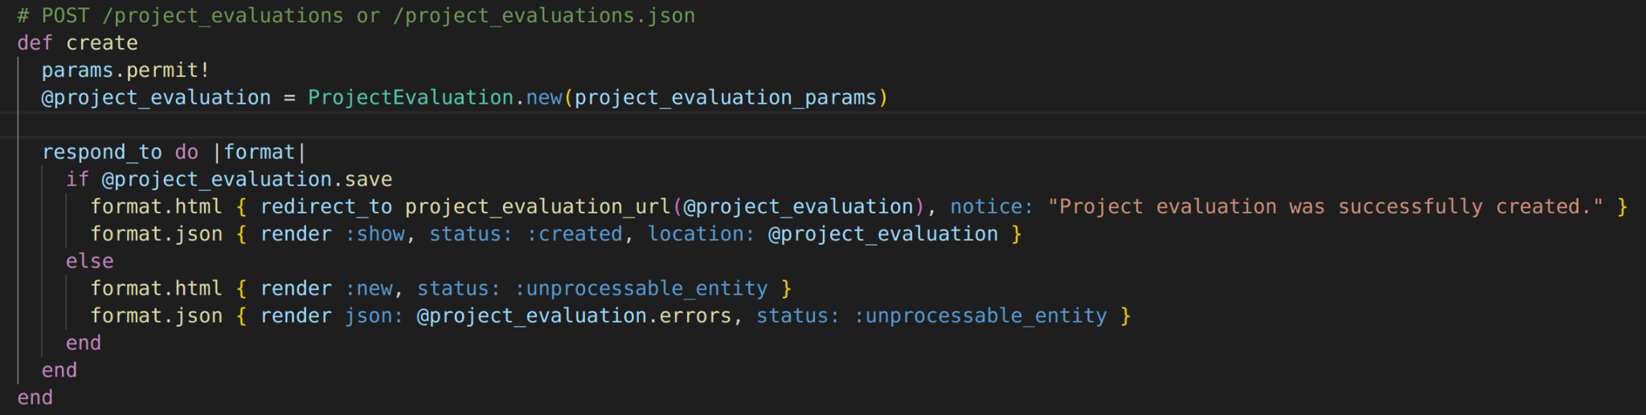
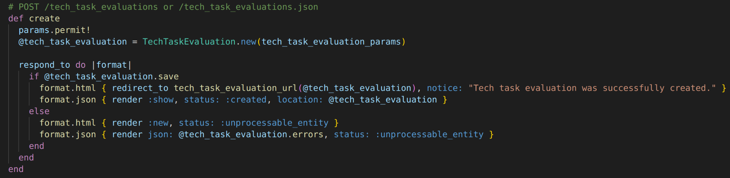
Evaluation: Controllers
Allowing create functions to pass all parameters so the TeamID can pass
controllers/project_evaluations_controller.rb
controllers/tech_task_evaluations_controller.rb

Slide 33
Evaluation Forms
Project Form
Manager ratings
Short response team questions
Tech Task Form
Overall manager rating
Short response team questions
Team selection drop down
views/project_evaluations/_form.html.erb

Slide 34
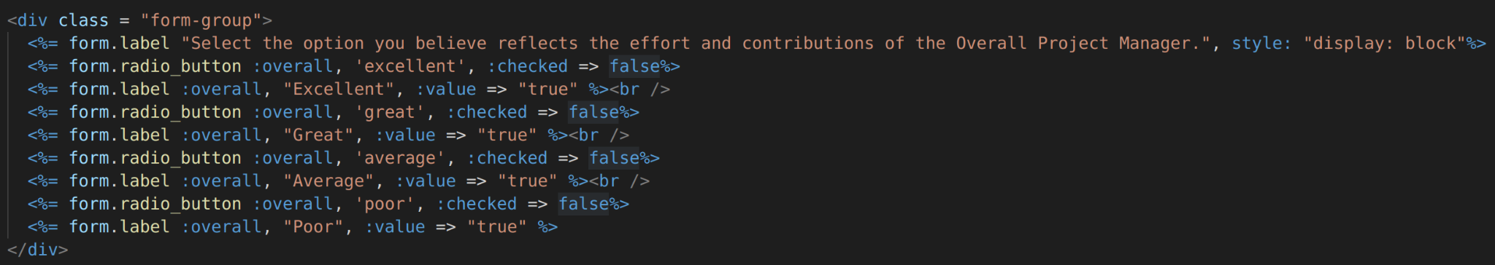
Evaluation Form Question Types
Multiple choice with Bootstrap styling
views/project_evaluations/_form.html.erb
Short answer with Bootstrap styling
views/project_evaluations/_form.html.erb

Slide 35
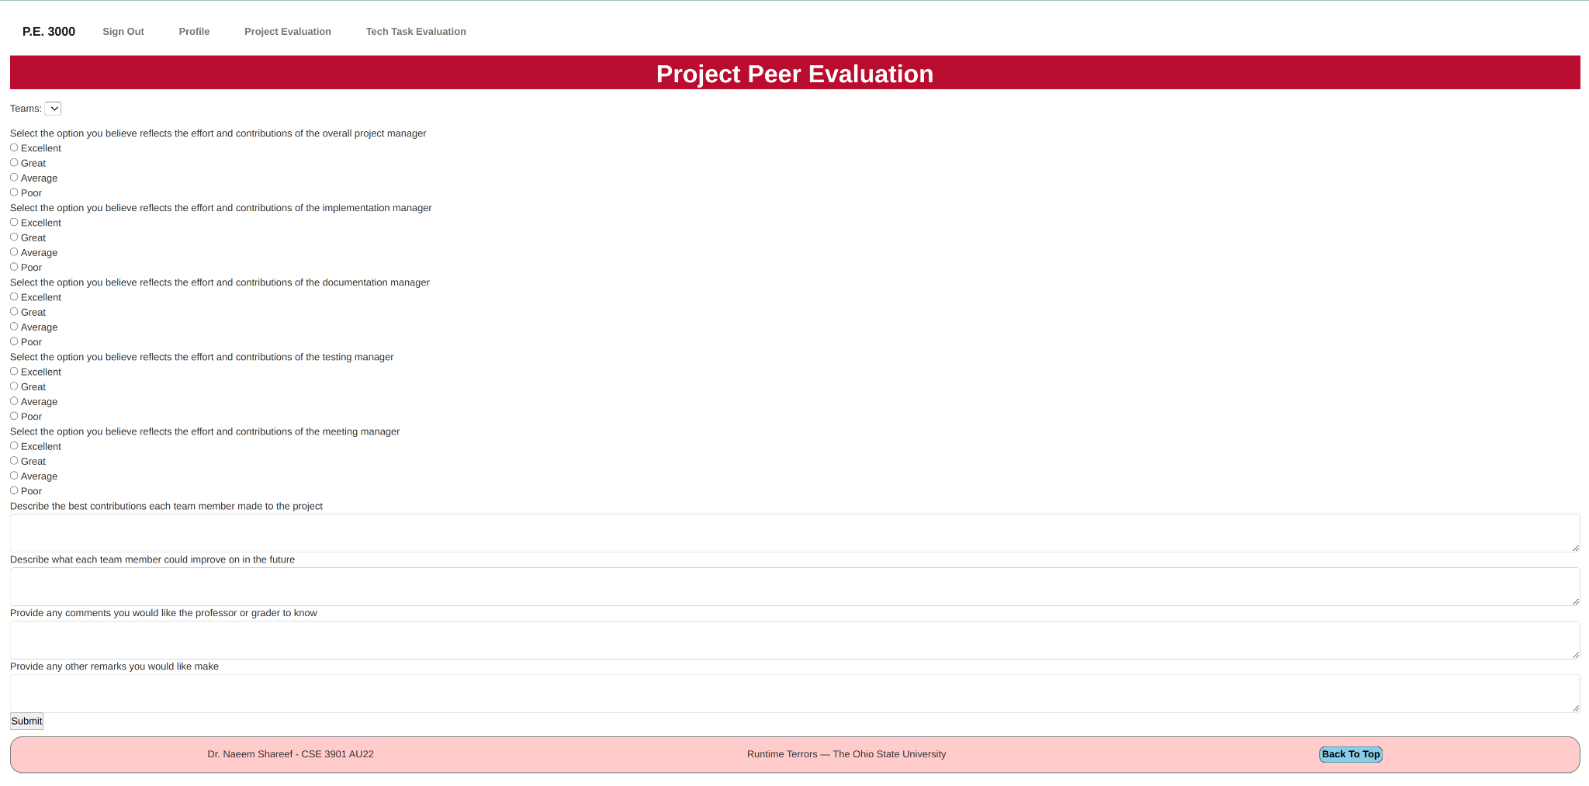
Project Evaluation Form

Slide 36
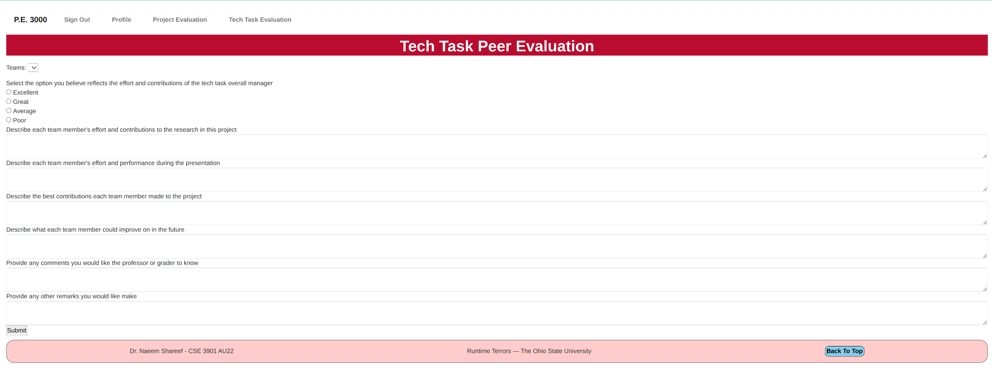
Tech Task Evaluation Form

